Slide 2
A Wales of Vibrant Culture and Thriving Welsh Language
A society that promotes and protects culture, heritage and the Welsh Language and which encourages people to participate in the arts and sport and recreation

Slide 3
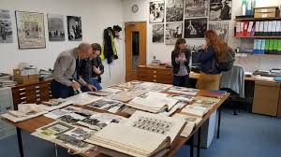
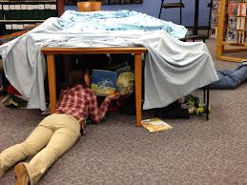
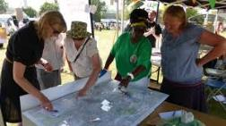
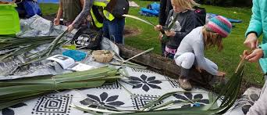
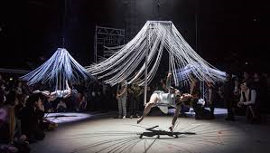
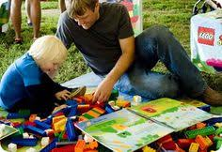
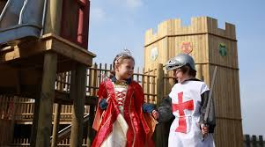
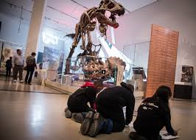
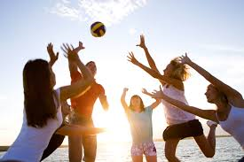
Culture is..?
Archives
Arts
Heritage
Language
Libraries
Museums
Play
Sport

Slide 4
Culture as part of a bigger whole
Environment
Economic
Social
Culture

Slide 5
The Art of the Possible
Art of the Possible will help public bodies to make The Act real.
Shining a light on great work that is improving well-being in communities across Wales; building on what already works.
Creating a community of citizens and doers with expertise who can challenge business as usual – to create public services that meet the needs of current and future generations.
We are learning from the past and the present, to build a better future.

Slide 6
7 people on secondment considering the 7 goals of the Act

Slide 7
Making Simple Changes
Being More Adventurous
Leading the Way

Slide 8
A Wales of vibrant culture and thriving Welsh language – Simple Changes
Ensure that all of your access points have bilingual greetings.
Use the Iaith Gwaith logo on lanyards and email signatures of all staff who are Welsh speakers
Encourage your staff to sign up for and use their free library card, providing accessible information on what the library offer
Engage in National Play Day
Promote opportunities for older people to engage in culture, through the Gwanwyn Festival.
Ensure that arts venues you work with are signed up to the National Access Scheme (Hynt)
Consider the opportunities to support and develop local clubs involved in sport
Give free access to Park Run on any publicly-owned land
Support and promote the Night Out Scheme
Ensure continued free access to museums, libraries and green spaces

Slide 9
Swansea High Street and Coastal Housing – culture supporting regeneration

Slide 10
Unloved heritage – Culture supporting young people to develop skills and access opportunities

Slide 11
Andrew’s story – culture as a mechanism to supporting employment opportunities

Slide 12
2 areas you can focus on…
The work of your organisation
How are you maximising your contribution to the cultural goal in your work?
How can you use culture as a mechanism to achieve your organisational well-being objectives?
Where can culture play a role in making a difference to the way you engage with and learn from your communities?
You as individuals
How can you utilise culture to support you in your work?
Can culture play a role in your own well-being path?

Slide 13
Diolch yn fawr carys.wynne-morgan@futuregenerations.wales carys.wynne@arts.wales

