Slide 1
Notes:
What I hope to do this afternoon is focus on some practical examples of how recent construction projects here in Wales are embedding the spirit of the Well-being of Future Generations Act. How they are making places, how they are focusing on communities, not just buildings. How they are improving health, designing out crime, encouraging us to socialise, connecting communities, enhancing our natural environments, providing secure jobs and using resources efficiently.

Slide 3
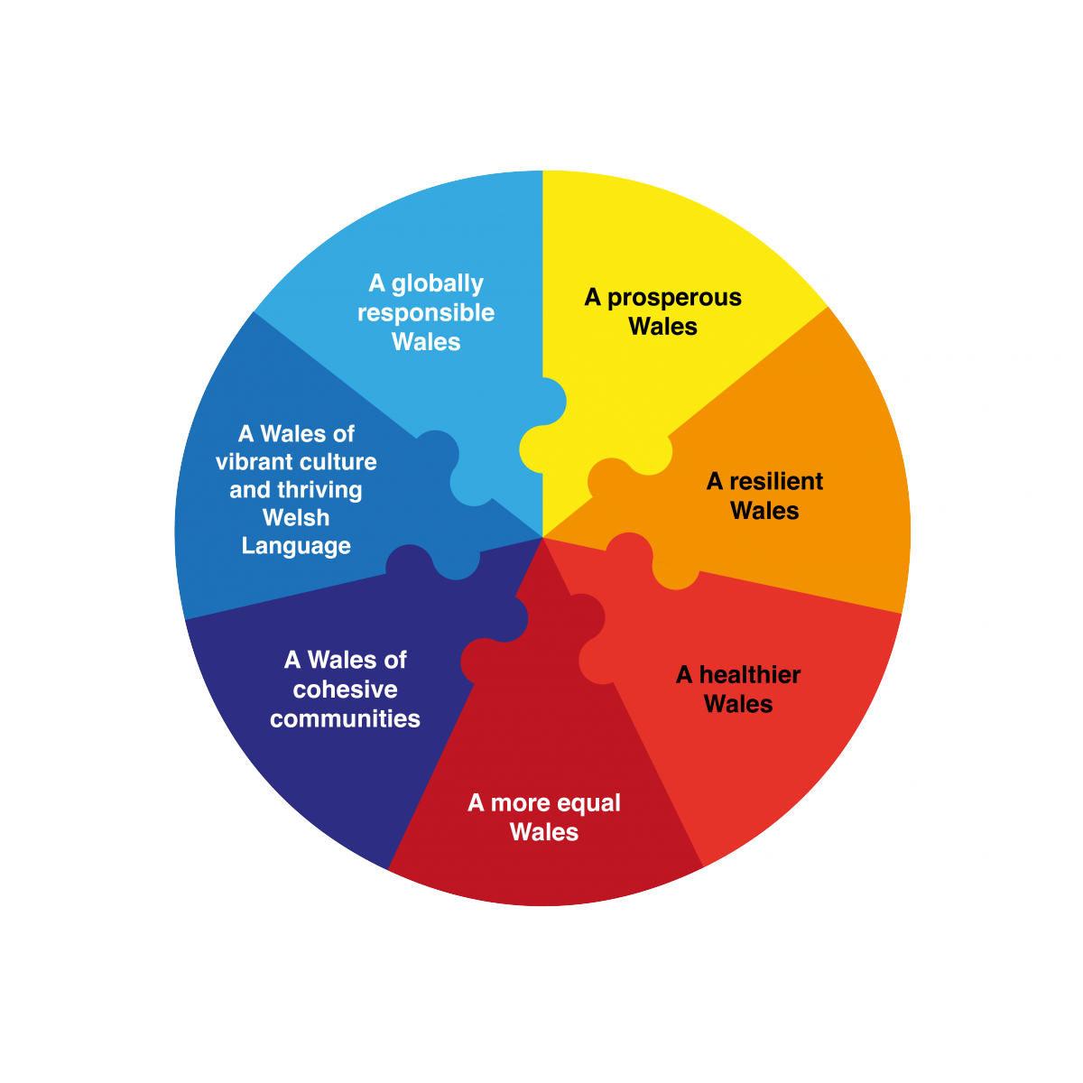
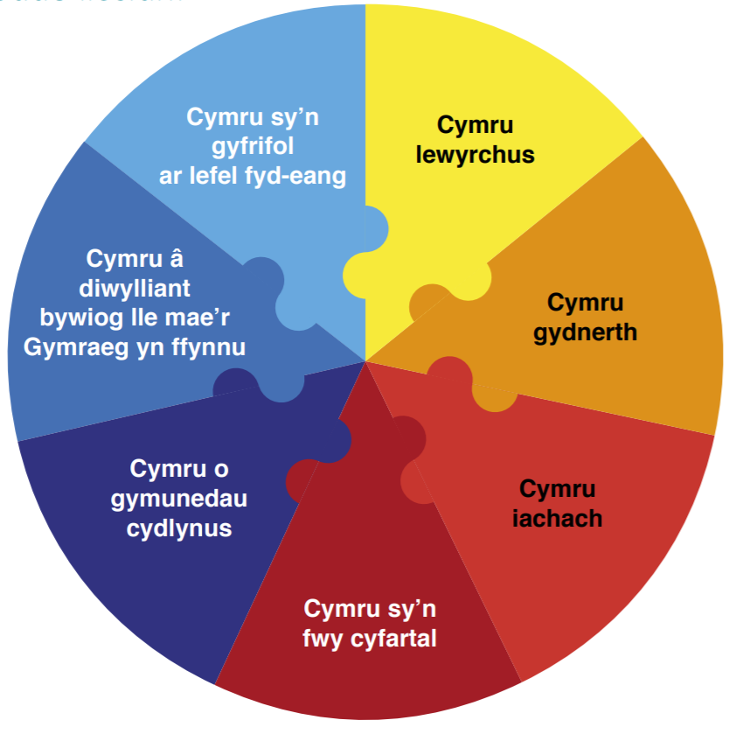
The Well-being of Future Generations Act

Slide 4
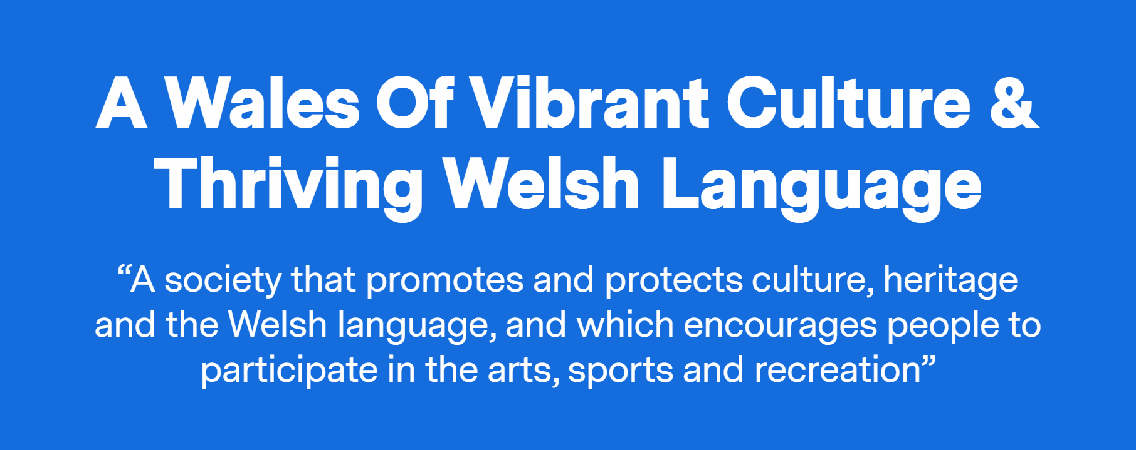
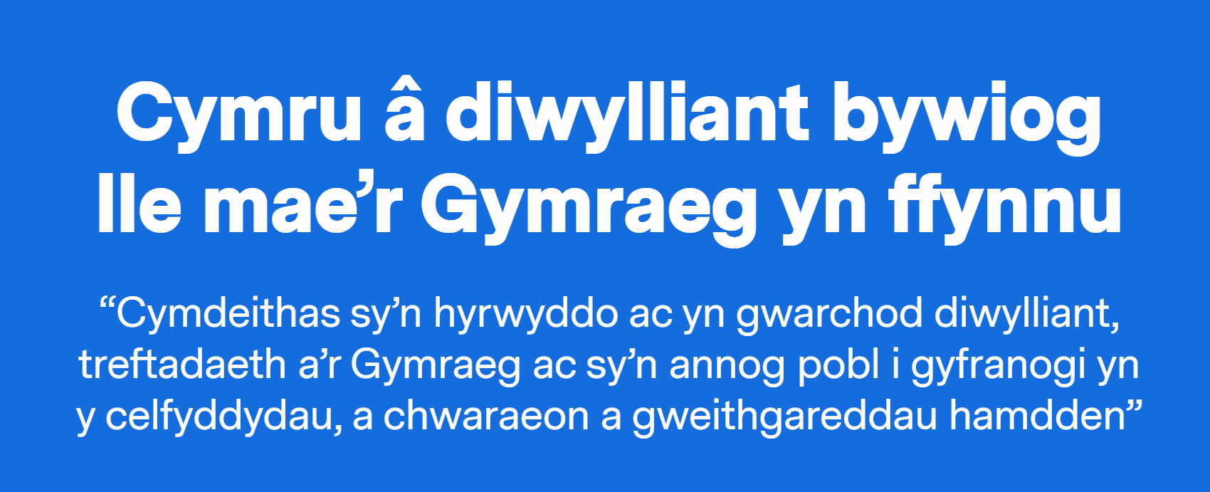

Slide 5
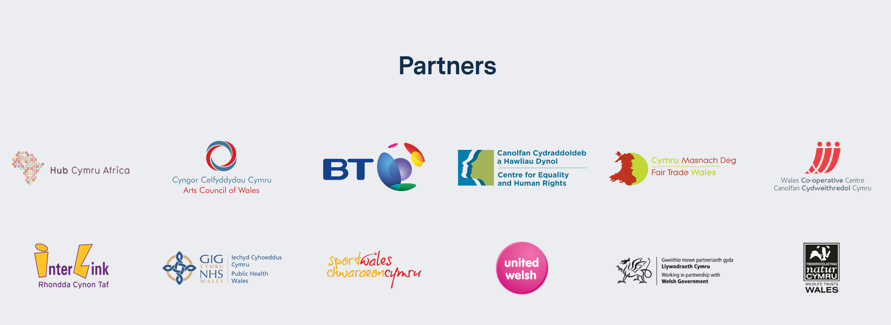

Slide 6
Promoting and protecting the Welsh language
Promoting and protecting culture and heritage, valuing their role as mechanisms for social change
Promoting and protecting culture and heritage, valuing their potential to achieve prosperity and resilience
Encouraging people to participate in the arts, sport and recreation, and valuing creativity
And finally, encouraging organisations to ensure that the arts, sport and recreation are available to all.

Slide 8
ENABLERS – achieving this goal is more likely to happen when…
There is a national and local cultural strategy​
Organisations understand how to make the most of local assets such as libraries, play facilities, museums, galleries, sports facilities, arts organisations, natural resources and historic buildings.​
There is understanding of the potential of creativity (particularly among cultural professionals) to support change in policy making and broader society;​
Business development in towns and cities is built around their cultural offer;​
There are innovative partnerships that allow for culture to be more visible in daily life, for example linking the culture and health agendas;​
Legacy projects show the long term impact of investment in culture and language.

Slide 9
DISABLERS – Achieving this goal is less likely to happen when…
The contribution of culture and the Welsh language to wider outcomes and the prevention agenda is not understood or valued;​
There is short term support or funding for time-limited projects or pilots, minimising the opportunity for lasting impact; ​
There is limited evidence or indicators to ‘prove’ value and impact; ​
Cultural and language activities take place in siloes;​
There isn’t a full picture of local cultural assets (including buildings, spaces, natural resources and people), and they aren’t linked to delivering broader objectives.

Slide 11
Diolch yn fawr
Thank you

