Slide 1
Gweithio gyda teuluoedd working with families
Dechrau’n deg ac Oriel mÔn yn cydweithio
Flying start and Oriel mÔn working in partnership

Slide 2
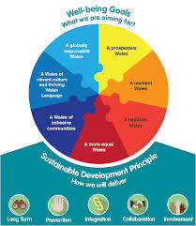
ORIEL MÔN

Slide 3
Flying start
Anglesey Flying Start brings together a number of agencies to ensure that all Flying Start children have a flying start in life by developing their language, emotional, physical and social skills to make sure that they are ready to start school.
Children up to 3 years 11 months may be eligible – depends on postcode (4 geographic regions in Anglesey). c.700 in Anglesey
Areas: Llangefni, Gwalchmai, Newborough, Holyhead
Enhanced health visiting
Parenting support programmes
Early language and play skills
Funded high-quality part time childcare

Slide 4
Working together
15 days additional to childcare offered (2.5 hours during term time) and includes 1.5 hour activity sessions during holidays
Advertised in groups, facebook etc by Flying Start. First come first served as places limited.
2 members of staff support each session
Outcomes for Flying Start
Families to spend quality time together
Able to offer a high quality creative activity for free
Develop social skills of children
Develop language skills of children

Slide 5
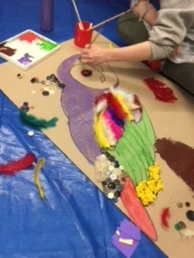
Art activities
Introductory sessions
Holyhead: 8 of 8 families attended
Llangefni: 5 of 8 families attended
Then 3 sessions held for the families: 12, 14, 10
Total: 34 children
Linking activity to collection
Free art activities for children as part of Oriel’s general programme of events

Slide 6
Feedback from families
Everything was great. Thank you. Snacks would improve the event.
Enjoyed spending time with the family. Would enjoy more pictures to paint. Had a good day, enjoyed myself.
Best part of the event was being creative.
Enjoyed the painting. Would like snacks (cake) next time.
Enjoyed everypart of the day.
Small number of people so felt comfortable.
Enjoyed the painting. Would like a cup of tea next time.
Best part of the event was the craft
Lots of resources. Would enjoy more activities. Always happy to take part in activities.
Best part of the day was letting the children be creative. Would like a panad and juice next time.
Great resources and interactive for children. Thank you for putting on a free event in the holidays.
Every aspect was great. Brilliant morning, staff were excellent.

Slide 7
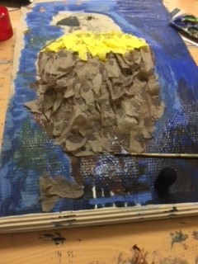
What next?
More sessions – and part of annual programme
Will keep group numbers small
Will introduce refreshments
Will be focusing on different exhibitions
Will look at introducing art sessions off-site
More in-depth evaluation, including Well-Being wheel (UCL)

