Slide 1
Prosiect Carbon Bositif: Cyflwyno datgarboneiddio sefydliadol Carbon Positive Project: Delivering organisational decarbonisation
Silas Jones
Rheolwr Prosiect Carbon Bositif
Carbon Positive Project Manager
Silas.Jones@naturalresourceswales.gov.uk

Slide 2
Carbon Positive Project: Delivering organisational decarbonisation
Project background
What the project has sought to deliver and how
Some key headlines from our work
Challenges we’ve faced
Projects delivered to reduce our carbon impact now
Next steps in decarbonising NRW
Key learning

Slide 3
Natural Resources Wales (NRW) is committed to positive action on climate change
Pursuing opportunities to decarbonise helps us to:
Deliver on NRW’s purpose to ensure the environment and natural resources of Wales are sustainably maintained, enhanced and used, now and in the future.
Deliver against the requirements of the Environment Act, e.g. contributing to Carbon Budgets and emissions reductions targets.
Maximise our contribution to the seven Well-being Goals under the Well-being of Future Generations Act, e.g. contributing to ‘an innovative, productive, low carbon society’ (A prosperous Wales).

Slide 4
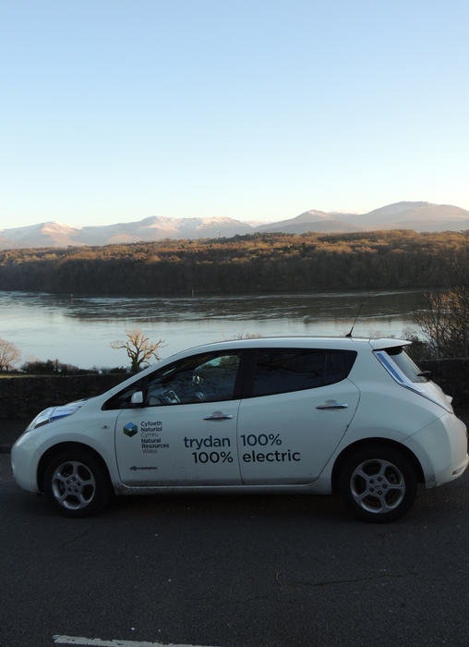
Carbon Positive Project
NRW becoming an exemplar in carbon management and sharing best practice for use across the Welsh public sector
Part of NRW’s wider work on climate change, e.g. adaptation action and enabling renewable energy on the estate.
Initially funded by the Welsh Government to show leadership in decarbonisation in Wales’ public sector and to share our approach and experience to help facilitate wider low carbon transition.
Exploring how our organisation can address its carbon impact across buildings, transport, land and operational assets, and procurement of goods and services.

Slide 5
How we delivered a comprehensive approach to carbon management
Calculating NRW’s net carbon status
2. Evaluating options for mitigation
3. Demonstration Projects
4. Communications and working with others
5. Developing an action plan
Notes:
Evaluated NRW’s net carbon status, accounting for both greenhouse gas emissions across our operations and the carbon captured annually (sequestration) across the estate, as well as estimating the existing stores of carbon (carbon stocks) on the estate.
The Project has identified opportunities to reduce the carbon impact of our organisation (mitigation measures) and delivered projects to demonstrate these measures.
This slide sets out the five key stages we’ve followed on the project:
Understanding our net carbon status – the balance of emissions and annual carbon captured in habitats on the estate we manage (sequestration). We identified our priorities for action from sources of emissions, annual carbon sequestration in our habitats, and we also understood the vital habitats that we need to continue to protect to ensure protect stored carbon and reduce the loss of carbon stocks (e.g. peatlands). We worked with industry experts to estimate carbon in woodland and peatland habitats.
Evaluating options for mitigation – we identified options available to NRW to reduce emissions, enhance sequestration and protect carbon stocks. We gathered information on the costs, carbon savings and wider benefits – including commissioning work with industry experts where evidence gaps were identified (e.g. on low emission vehicles, renewable energy and building measures). We also looked at the scale at which NRW could adopt these opportunities moving forward. We’ve used this information to develop a method of prioritising our options for delivery.
We delivered a series of over 20 demonstration projects to showcase the mitigation opportunities we identified for NRW and to pilot approaches, for example introducing electric vehicles and charging points.
Throughout the project we have sought to learn from organisations managing their own carbon impact in new and ambitious ways, as well as collaborating with our colleagues internally to gather ideas and embed best practice.
We are producing a series of publications to record and share our experience and approach, these will be available on our webpages early next year (2018). Our next step is to build our mitigation opportunities into a plan for implementation, to embed carbon management across the organisation.

Slide 6
Governance
Our core project team for delivery:
Silas Jones– Project Manager
Ffion Williams (maternity cover for Anna Jones) – Carbon Management and Climate Risk Advisor
2 Carbon Positive Advisors – Filled but not yet started work
Working together with Clive Walmsley – Senior Climate Change Advisor
We built up a wider Practitioners Group of key staff across NRW; contributing specialist knowledge, delivering demonstration projects and helping to embed carbon management across the organisation.
Overseen by our Project Steering Group; engaging leadership and management from across the organisation in decarbonisation.
Moving governance to a Climate Change and Decarbonisation Board

Slide 7
NRW’s net carbon status
Our net carbon status is the balance of our emissions and sequestration.
We emit less carbon from our operations than is captured annually (our sequestration) by habitats on the estate – this gives us a net carbon positive status.
Notes:
NRW has a unique and broad organisational remit, including being a custodian of over 7% Wales’ land area (largely afforested).
Our role as custodian and manager of this land opens opportunities, e.g. on peatland restoration, renewable energy, woodland planting.

Slide 8
A comprehensive approach
We took a broad view of the organisation and it’s emissions and sought to understand the role of the land we own and manage for carbon storage.
Notes:
Scope 1: Direct Scope
2: Energy Indirect, Consumption of purchased electricity, heat, steam and cooling
Scope 3: Other Indirect, Purchased materials and fuels, Transport-related activities, Leased assets, franchising and outsourcing

Slide 9
Understanding our priorities
The calculation of our net carbon status was a stepping stone to identifying our mitigation options.
Electricity and heating fuel (5%) and vehicle fuels (6%) are a priority
Procurement accounts for our greatest source of emissions (59%)
Also employee commute, electricity use in operational assets, timber haulage
Woodland habitats are our main potential source of sequestration
Emissions from deep peat soils is significant
Notes:
Procurement - work carried out by contractors and under agreements (e.g. civil engineering of flood schemes, ICT, forest harvesting)

Slide 10
Shaping our approach
Buildings
Transport
Procurement
£
Land and
Operational Assets
Notes:
We shaped our approach around four categories that were easily accessible to other public sector bodies.

Slide 11
Evaluating our mitigation options
1. Identifying feasible options to reduce emissions, increase sequestration and/or protect carbon stocks.
2. Gathering key information to evaluate options:
- costs
- carbon benefit
- wider benefits
Many of these opportunities are not unique to NRW and can be taken forward by others now.
Challenges: Procurement
Behavioural change
Notes:
Broad approach applying general principles to the whole organisation.
i.e. Solar PV on all buildings
Might not be suitable for all sites.

Slide 12
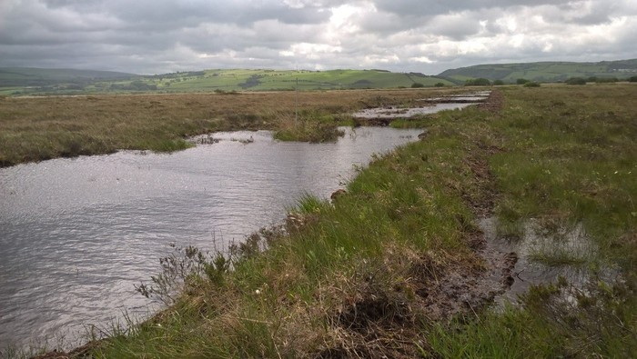
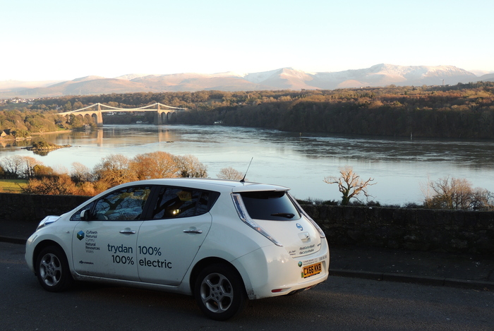
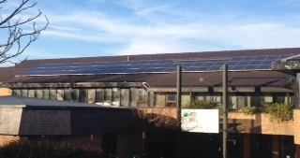
Demonstration Projects
100% renewable electricity supply -EDF
Solar panels
LEDs
Biomass boilers
Behavioural change campaigns
Electric vehicles and charging points
Active travel
Peatland restoration
Woodland planting
Retrofitting operational assets with solar PV
Notes:
These are crucial to demonstrate to key personal as well as the wider workforce that these projects are effective, deliverable and don’t impact on delivery.

Slide 13
Prioritising measures for delivery
We have:
- our measures
- metrics (costs, carbon benefits, wider benefits)
- the potential scale of adoption
Mitigation measures are being prioritised using:
- carbon benefit – using the total carbon savings or sequestration over the lifetime of the measure.
- costs – understanding the lifetime cost of each measure by calculating the Net Present Value (NPV) where possible.
This allows us to prioritise measures based on which of the options would provide the greatest carbon benefit for the least cost – building a strong business case for change.
We seek to optimise the multiple benefits measures can provide, further strengthening the business case.

Slide 14
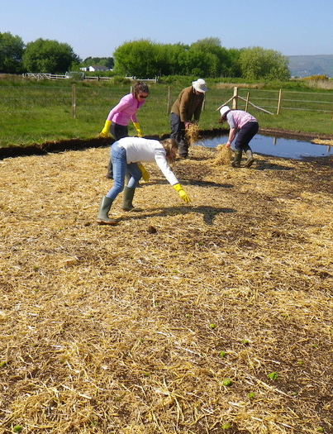
Developing a action plan for delivery
Timescales
Resources (time and money)
Knowledge and skills
Develop a detailed business case and project plan for each measure(s), including:
- building specific audits
- recognise operational needs
- environmental assessments, permits or planning requirements
- detailing and developing multiple benefits

Slide 15
Example Project
Decarbonising the NRW Fleet
Cenex report – fleet options and related emission reductions potential
Recommendations
EV’s – 56% of fleet = 27% emissions reduction
Telematics
Fleet reduction
EV charging infrastructure options study
Notes:
The review concluded NRW could save up to 27% emissions from their fleet and deliver a 5% cost saving through the use of existing low emission technologies. Whilst not all of NRW’s fleet use is suitable for current ULEV use, they calculated that replacing 56% of it with electric vehicles could save £136,000 and 413 tonnes of CO2e per year.

Slide 16
Decarbonising the NRW Fleet
Commissioned Urban Foresight to:
Asses site suitability for charging infrastructure
Provide insight into procurement options and routes
Long term strategic view - smart enabled, grid services
Working to finalise a strategy and develop procurement specifications

Slide 17
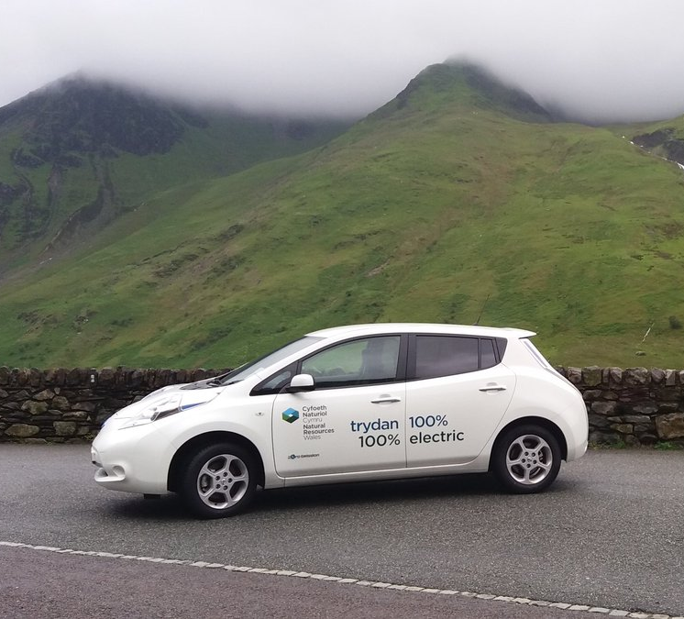
Planning future implementation
Programme measures into a plan for delivery moving forward and embed decarbonisation across the organisation.
Building a strategic, costed and prioritised programme of delivery for NRW to address our carbon impact over the next 3-5 years.
Supported by a robust evidence base to facilitate delivering decarbonisation across our organisation.

Slide 18
Learning from our experience
Taking a whole organisational approach to decarbonisation gives you a clear view of priorities for action and the measures to address them.
A change in culture to consider carbon alongside more conventional priorities such as cost and time.
Most delivery will need to be incorporated within the day-to-day decision making and work of our staff, contractors and partners.
Decarbonisation is a long term commitment and will be challenging - there is still work to be done, for example:
- solutions to short building leases
- charging infrastructure to support EVs
- understanding the role of the estate, e.g. for renewable energy
- identify potential collaborations and multiple benefits

Slide 19
Learning from our experience
Gaining organisational commitment is essential
Engaging others, internally and externally, is key to success
Basing decisions on robust evidence supports a strong case for change
Notes:
Climate emergency declaration have been a game changer in terms of commitment from our board
This has lead to increased cooperation and we are being pushed

Slide 20
Sharing our approach
Further information can be found in a series of materials:
Project key highlights infographic
Carbon Positive Project Summary Report
Calculating NRW’s Net Carbon Status Technical Report
Evaluating NRW’s Mitigation Options Technical Report (coming soon)
Demonstration Project Case Studies (coming soon)
Find out more online at:
www.cyfoethnaturiol.cymru/carbonbositif
www.naturalresources.wales/carbonpositive

Slide 21
Diolch yn fawr
Thank you
Silas Jones
Rheolwr Prosiect Carbon Bositif
Carbon Positive Project Manager
silas.jones@naturalresourceswales.gov.uk

Slide 22
Learning from others
From the beginning, we learnt from the ambitious and innovative approaches of others across the public, private and third sectors, for example:
Ambitions to be Carbon Positive at Manchester Fire and Rescue Service
Procurement in BT – stringent requirements in tender criteria for supplier action on climate change,
Mitigation measures at National Trust – practical experience in energy efficiency, electric vehicle charging infrastructure and green energy.
We also benefitted from gathering our own staff’s ideas and existing approaches in our organisation. Our staff were pleased to see the organisation taking positive action on climate change.

Slide 23
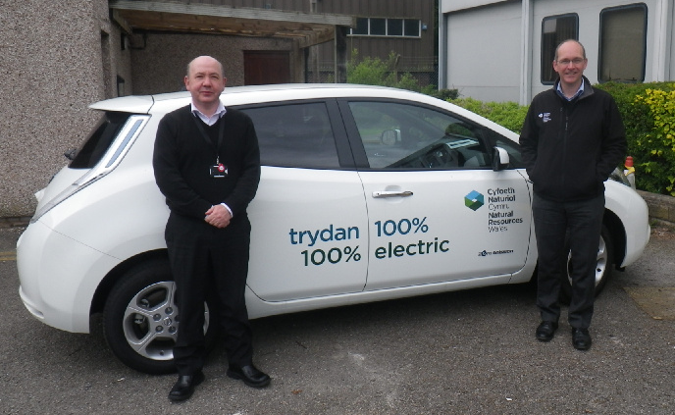
Challenges: The role of behavioural change
Some of our key priorities are influenced by the behaviour of our staff, e.g. energy use, business travel and employee commute.
Challenges:
Difficult to predict and measure impact
Large organisation with over 1800 staff across over 60 sites
Diverse sites and fleet
Developing universal materials
Uncertainties around potential to scale up and over time

Slide 24
Challenges: Reducing carbon in our procurement
Challenges:
Diversity of goods and services purchased
Significant numbers of suppliers
Limited influence over some aspects of our supply chain
Addressing these challenges requires long-term commitment, engagement with suppliers and influencing the National Procurement Service (NPS).

